Slide 1
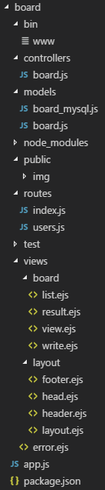
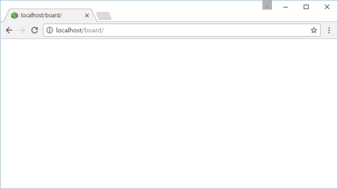

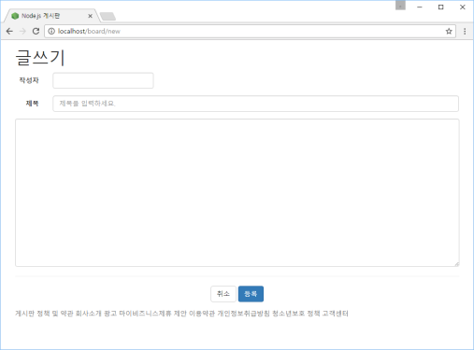
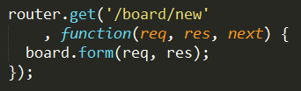
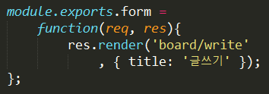
http://localhost/board/new 요청
Controller
Web browser
www
app.js
2
logger
bodyParser
1
cookieParser
static 자원처리
session
......
routes
3
6
View
error handling
header.ejs
layout.ejs
body
4
footer.ejs
write.ejs
board.js
layout.ejs
5
view engine(ejs)

Slide 2
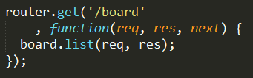
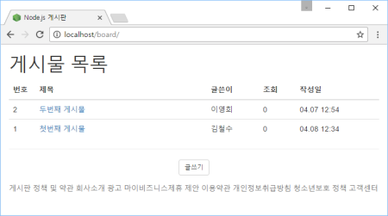
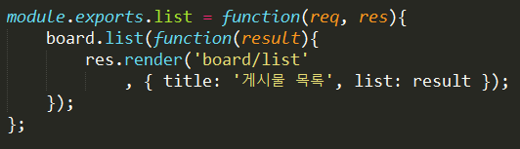
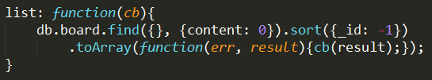
http://localhost/board 요청
Controller
Web browser
www
app.js
2
...
1
routes
3
4
board.js
7
8
View
5
Model
header.ejs
layout.ejs
board.js
body
footer.ejs
list.ejs
layout.ejs
view engine(ejs)
6
MongoDB

Slide 3
Controller
www
app.js
routes
bodyParser
board.js
cookieParser
Model
session
...
controllers
routes
error handling
board.js
board.js
View
MongoDB
layout.ejs
Oracle
MySQL
list.ejs

